Slide 1
Control Hardware in the Loop of Voltage Source Converters (VSCs)
SUNRISE Summer School
Belgrade 10-13/9/2024
Manuel Barragán Villarejo
Department of Electrical Engineering
University of Sevilla
(manuelbarragan@us.es)

Slide 2
Outline
General overview of Typhoon HIL
Schematic Editor
HIL SCADA
Interface Typhoon-HIL 402 to DSP TMS320F28335
DSP TMS320F28335
Code composer studio
Description of the main.c file in CCS
Selection of control parameters

Slide 3
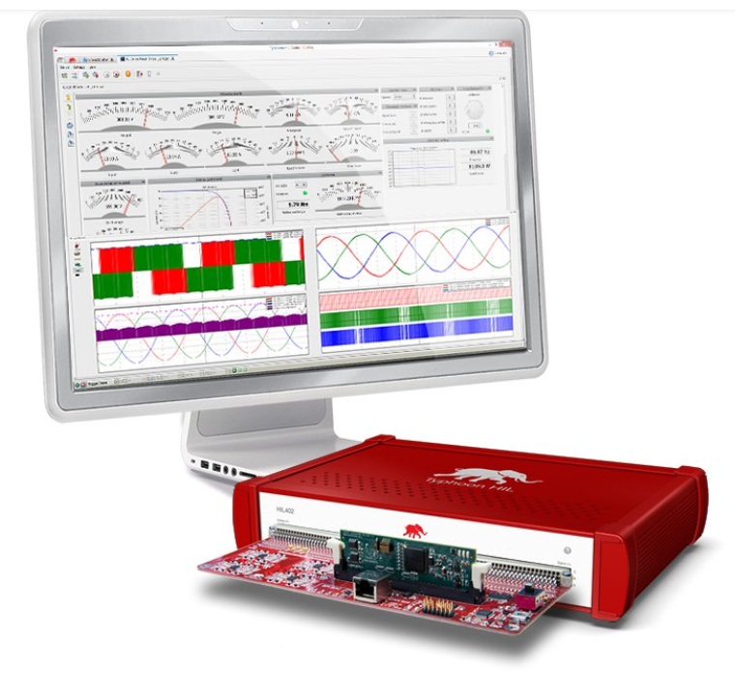
General overview of Typhoon HIL 402/404
Functionalities:
Real time simulation
Control Hardware in the Loop: C-HIL
Power Hardware in the Loop: P-HIL
Hardware:
Real time platform
HIL DSP Interface
DSP
Software:
Schematic editor
HIL Scada
Typhoon Test
Typhoon RCP

Slide 4
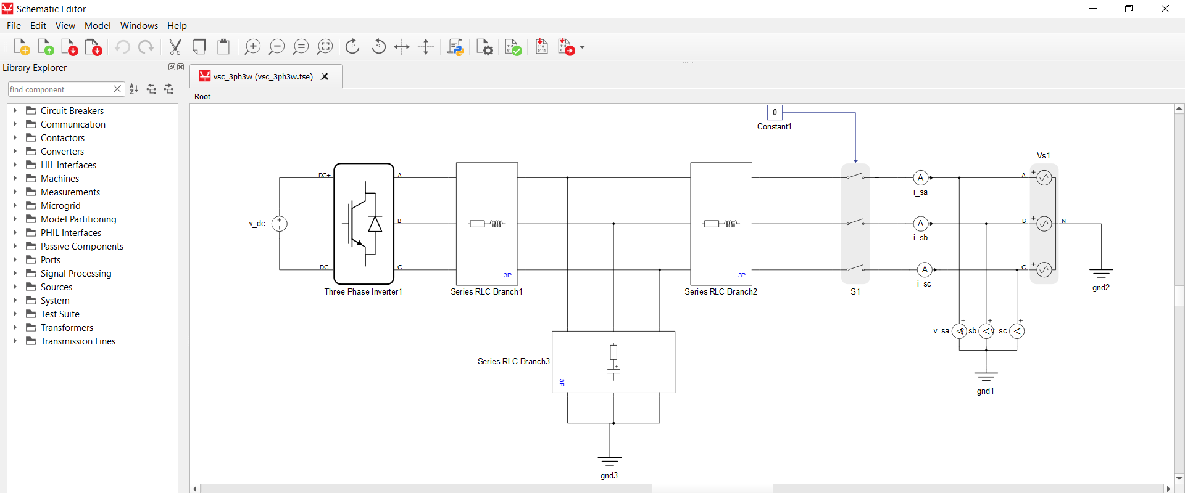
Schematic Editor

Slide 5
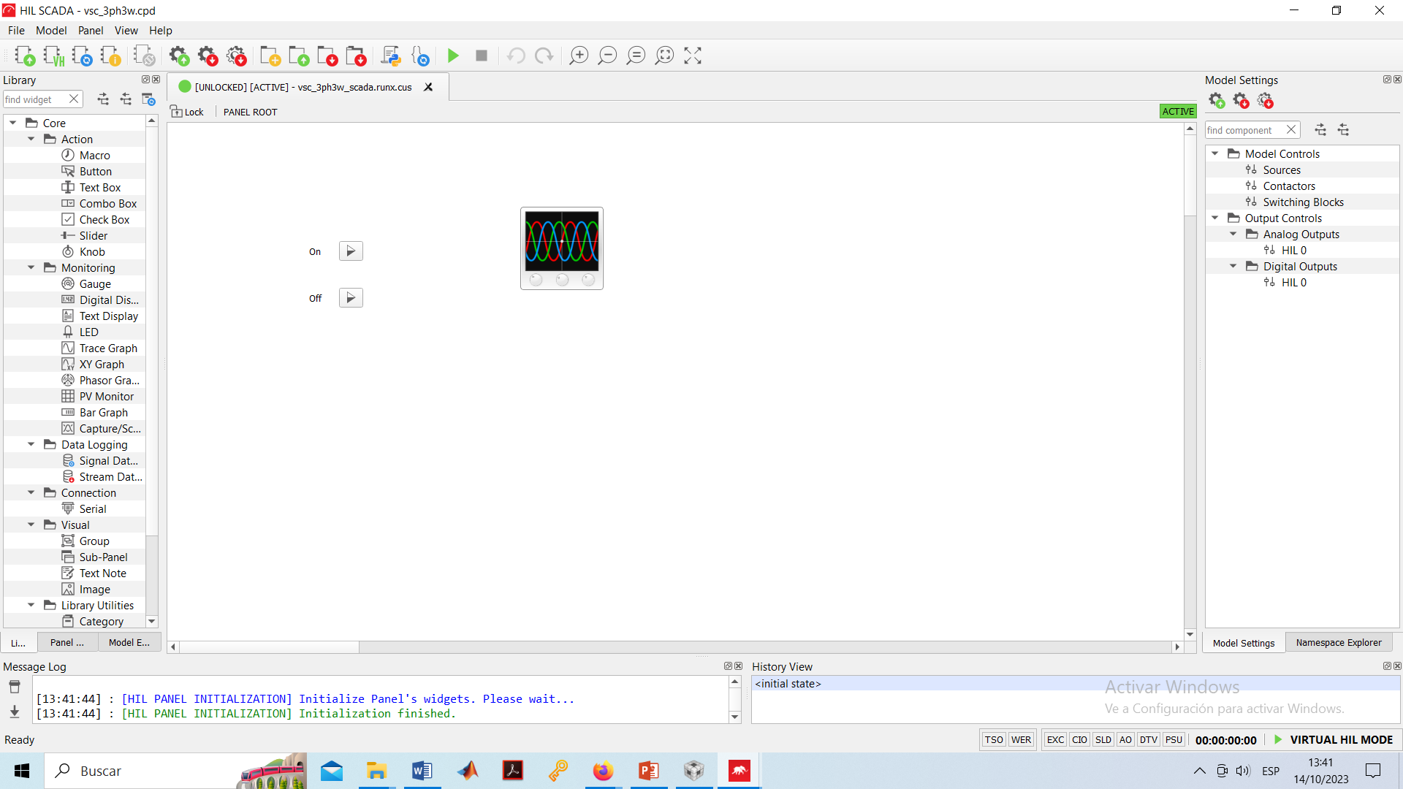
HIL SCADA
https://www.typhoon-hil.com/documentation/typhoon-hil-api-documentation/typhoon_api.html#
https://www.typhoon-hil.com/documentation/typhoon-hil-software-manual/References/action_widgets.html

Slide 6
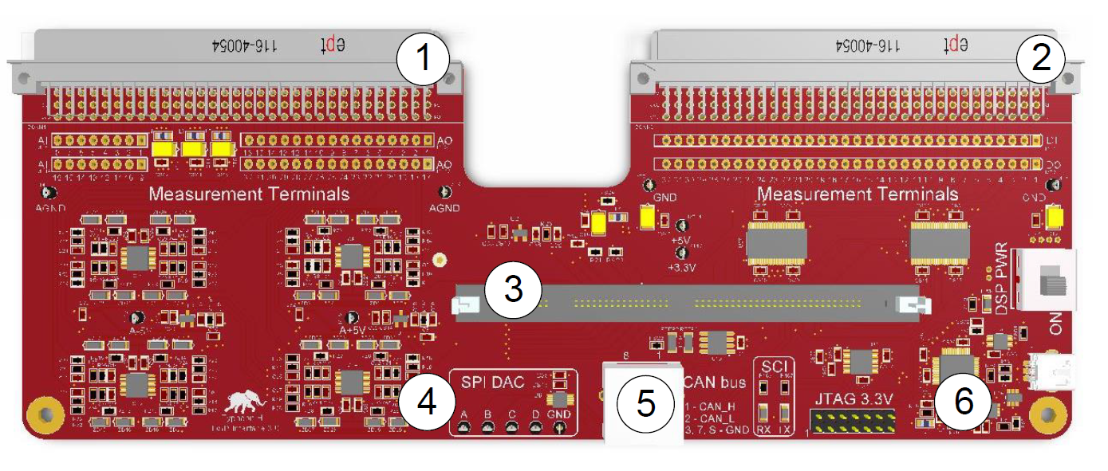
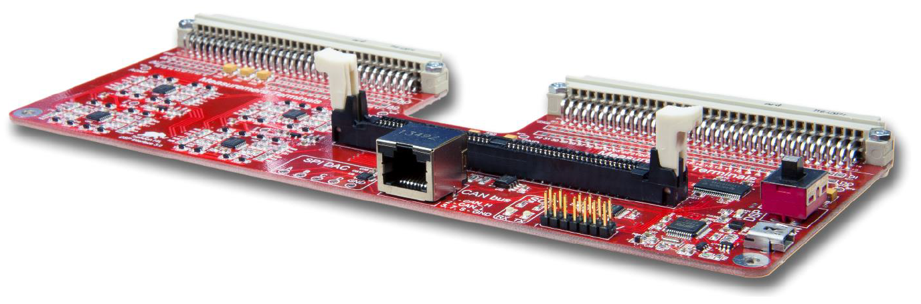
Interface Typhoon-HIL 402/404 to DSP TMS320F28335
DSP Interface
Analog signal connector
Digital signal connector
DIM100 control card connector
SPI (Serial Peripheral Interface) DAC
CAN bus
XDS100v2 and UART

Slide 7
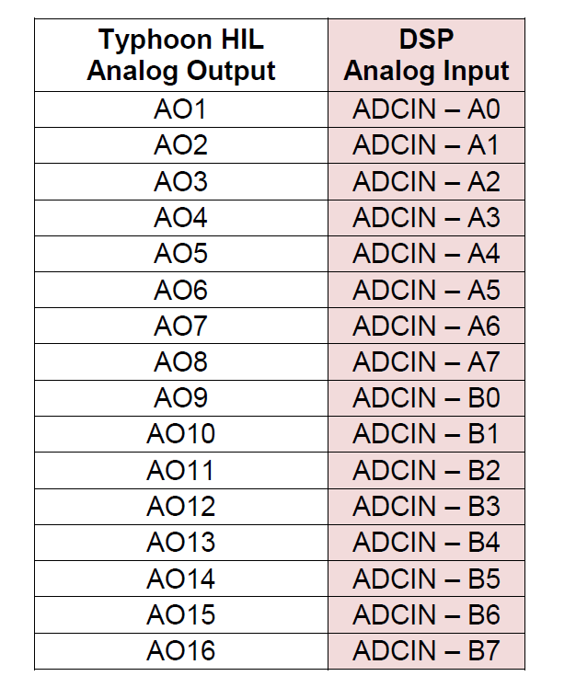











Interface Typhoon-HIL 402/404 to DSP TMS320F28335
DSP Interface
Analog signal connector
Buffer ADC. CCS
03
02
00
09
10
11
01
04
05
06
07
08
$i_{sc}$
$v_{uc}$
$i_{uc}$
$i_{dc}$
$i_{sn}$
$v_{dc}$
$v_{sc}$
$i_{sb}$
$v_{sb}$
$i_{sa}$
$v_{sa}$

Slide 8
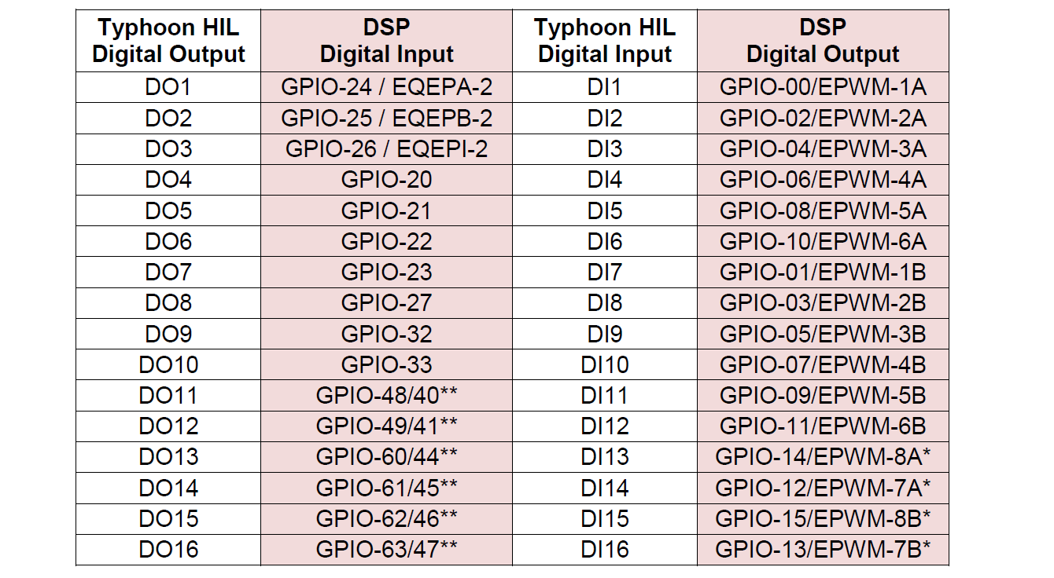
Interface Typhoon-HIL 402/404 to DSP TMS320F28335
DSP Interface
Digital signal connector
PWM: Top phase C
PWM: Top DC/DC
PWM: Top phase A
PWM: Top phase B
Interrupt
Enable DC
PWM: Bottom phase C
PWM: Bottom DC/DC
PWM: Bottom phase A
PWM: Bottom phase B
Enable AC

Slide 9
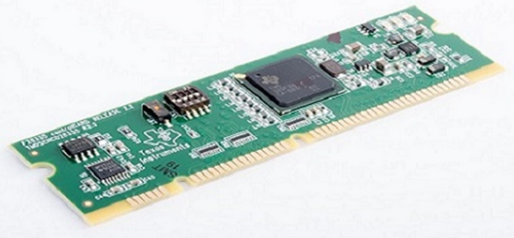
DSP TMS320F28335
Up to 150 MHz (6.67-ns cycle time)
On-chip memory: 256K × 16 flash, 34K × 16 SARAM
Peripherals: 3.3-V I/O design
Up to 18 PWM outputs
12-bit ADC, 16 channels
Up to 88 individually programmable, multiplexed GPIO pins with input filtering
Serial port peripherals
Up to 2 CAN modules
Up to 3 SCI (UART) modules
https://www.ti.com/lit/ds/symlink/tms320f28335.pdf?ts=1725436907130&ref_url=https%253A%252F%252Fdev.ti.com%252F

Slide 10
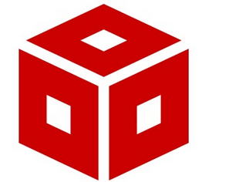
Code composer studio
Code Composer Studio is an integrated development environment (IDE) for TI's microcontrollers and processors. It comprises a suite of tools used to develop and debug embedded applications.
Includes an optimizing C/C++ compiler, source code editor, project build environment, debugger, profiler and many other features
Compilers for proprietary architectures such as MSP430TM, C2000TM and DSPs are included as well as a compiler for Arm®-based microcontrollers
*Presentation installation_CCS provided contains the details for installation and configuration of CCS

Slide 11
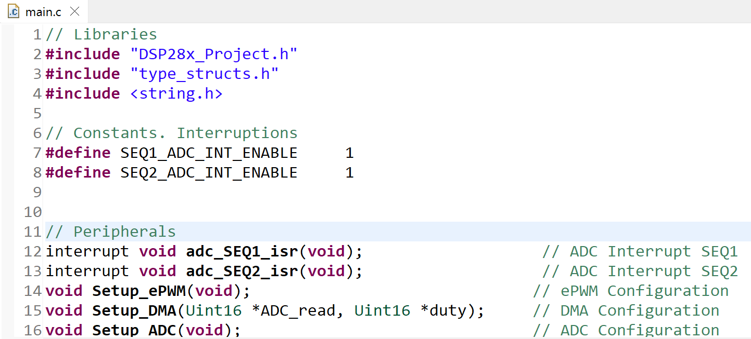
Description of the main.c file in CCS
DSP initialization and configuration is performed
VSC control functions are executed
From Line 1 to Line 63.
Libraries
Functions for configuring peripherals
ADC Conversion
PLL & Park transformation functions
Fault State Machine (FSM)
Control functions based on PLL:
Control functions based on VSG:
Auxiliary computations
Global variables

Slide 12
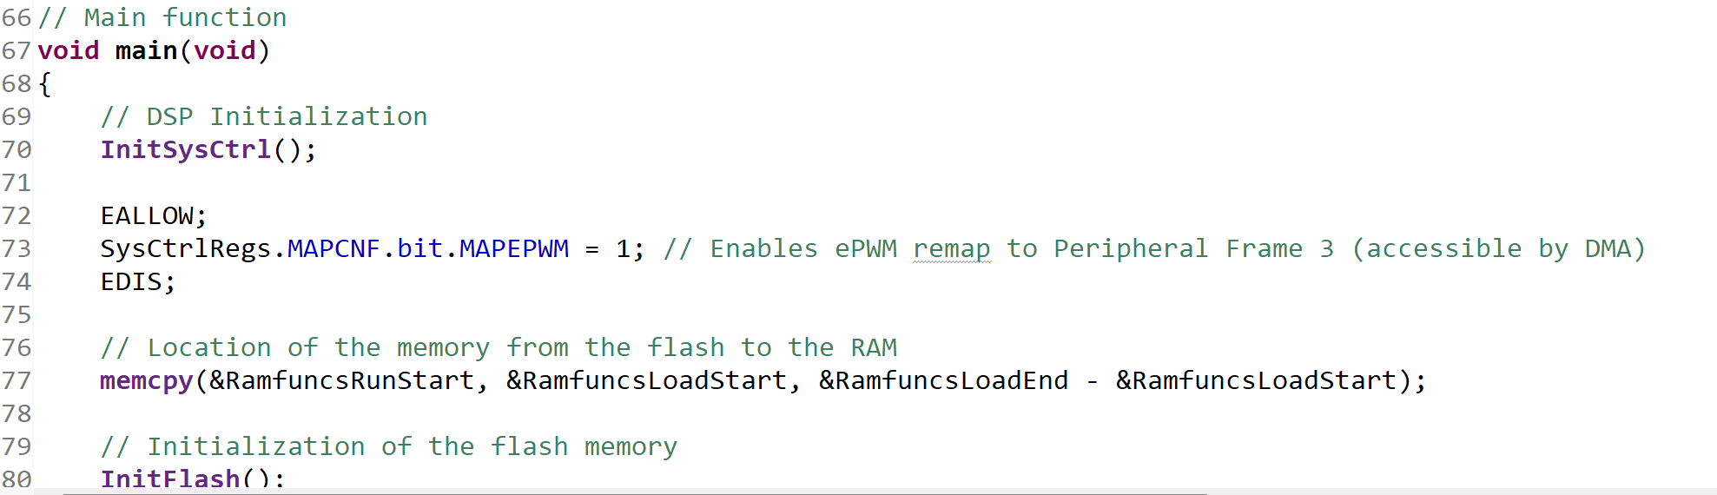
Description of the main.c file in CCS
From Line 66 to Line 141. ‘main’ function
DSP Initialization
Initialization of the flash memory
Clock frequency definition
GPIOs Initialization and Configuration
Interrupts Initialization
DMA Initialization
ADC Initialization
ePWM Initialization

Slide 13
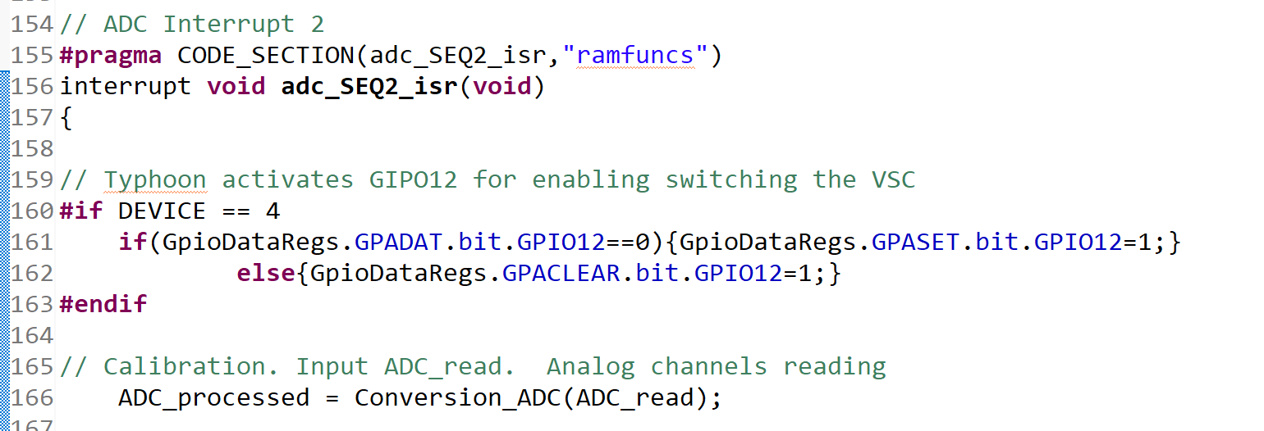
Description of the main.c file in CCS
From Line 143 to Line 151. ADC interruption 1 for ADC
From Line 154 to Line 225. ADC interruption 1 for control loop
GIPO12 for enabling switching the VSC
Calibration. Input ADC_read. Analog channels reading
RMS computation. Input ADC converts to Volts and Amps
power computation
PLL and Park transformation
State machine
Enable/disable ePWM
Controller selection
Carrier based PWM
Reinitialize for next ADC sequence

Slide 14
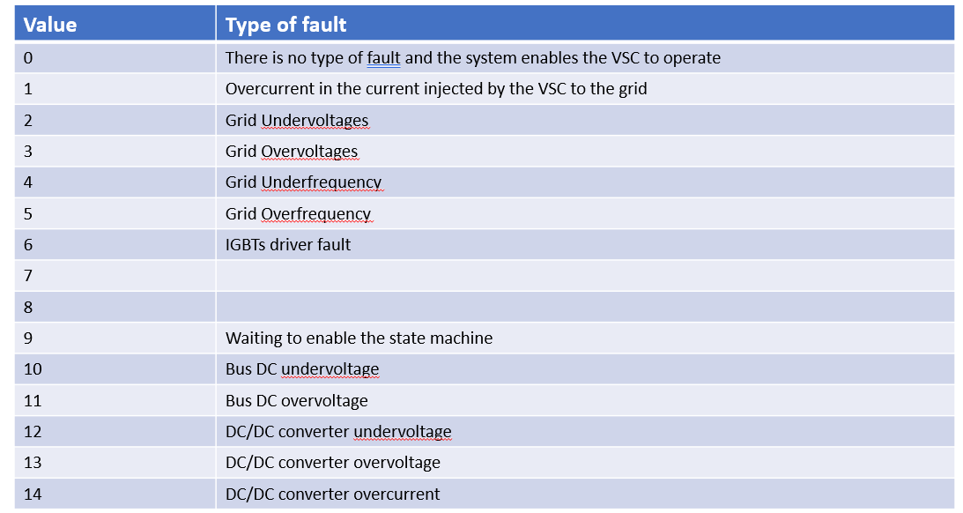
Description of the main.c file in CCS
File ‘State_machine.c’. Function state_mac. Table with type of Faults

Slide 15
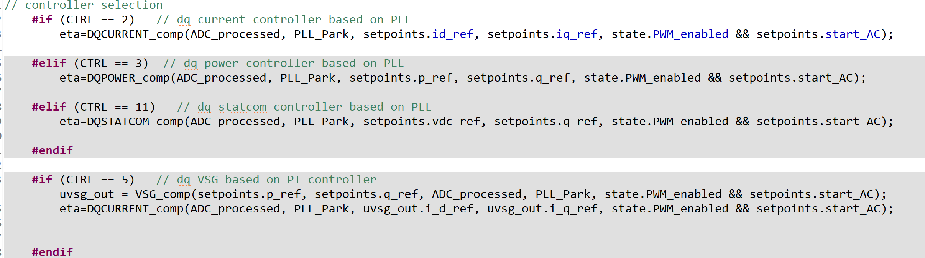
Description of the main.c file in CCS
Controller selection
Function DQCURRENT_comp→ dq current controller
Function DQCURRENT_comp→ dq power controller
Function DQSTATCOM_comp→ dq statcom controller
Function VSG_comp→ dq vsg controller

Slide 16
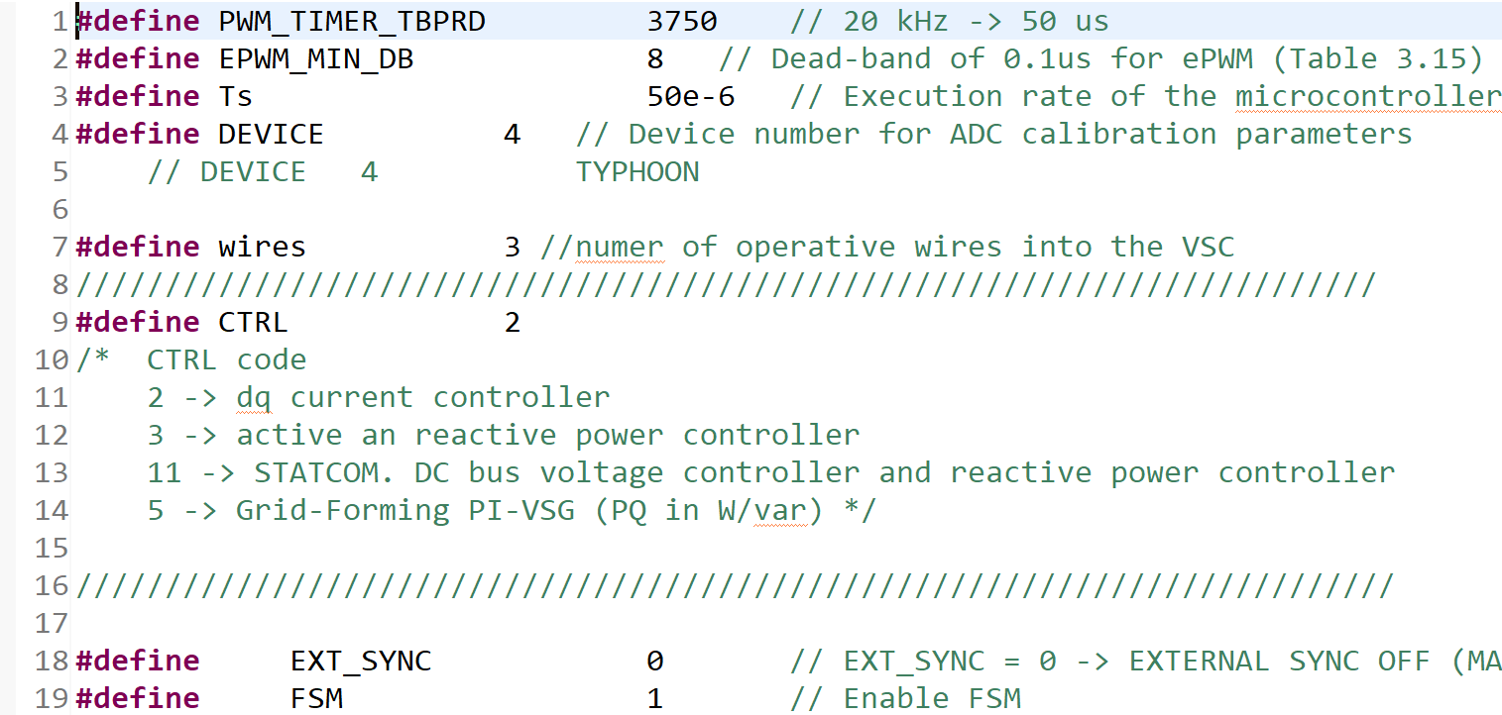
Selection of control parameters
Header file: type_structs.h
PWM timer
Dead-band PWM
Execution rate of the controller
Device to which the dsp connects
Number of wires of the VSC
Controller selection
Synchronization of the DSP
Enabling the state machine
ADC calibration
Limits of operation of the VSC
Controller gains
Structures: They are a way to group several related variables into one place

Slide 17
Outline
General overview of Typhoon HIL
Schematic Editor
HIL SCADA
Interface Typhoon-HIL 402 to DSP TMS320F28335
DSP TMS320F28335
Code composer studio
Description of the main.c file in CCS
Selection of control parameters

Slide 18
Control Hardware in the Loop of Voltage Source Converters (VSCs)
SUNRISE Summer School
Belgrade 10-13/9/2024
Manuel Barragán Villarejo
Department of Electrical Engineering
University of Sevilla
(manuelbarragan@us.es)

